Slide 1
Decision Problem of Finite Automata
Prof. Ritesh Upadhyay
Assistant Professor, Dept. of Computer Engineering.
UVPCE, Ganpat University

Slide 2
Decision Problem of FA : Its means which problems are decidable in context of FA.
There are 4 Decision problems of Finite
Automata.
Membership Problem
Emptiness Problem
Finiteness Problem
Equivalence Problem

Slide 3
Membership Problem
Membership Problem means how can we say
that any string is member of a particular
Language or not??
With the use of Acceptance mechanism, we may easily identify that a particular string is the member of a language.

Slide 4
Emptiness Problem
Emptiness Problem : Checking whether the
finite automata is accepting empty language or
non- empty language .
Step:1 Eliminating the States which are not reachable from initial state.
Step:2 In Remaining Automata if there exists at least 1 final state then Automata will accept non- empty language otherwise empty language.

Slide 5
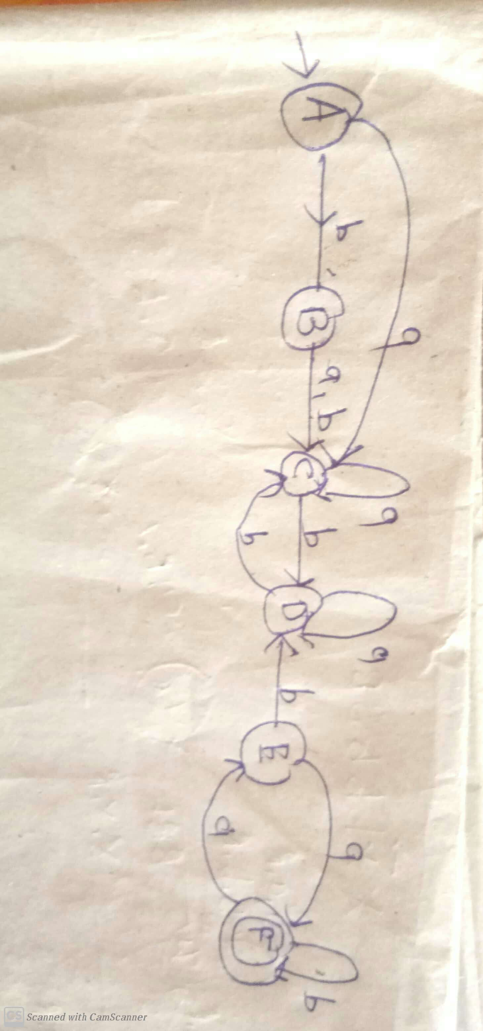

Slide 6
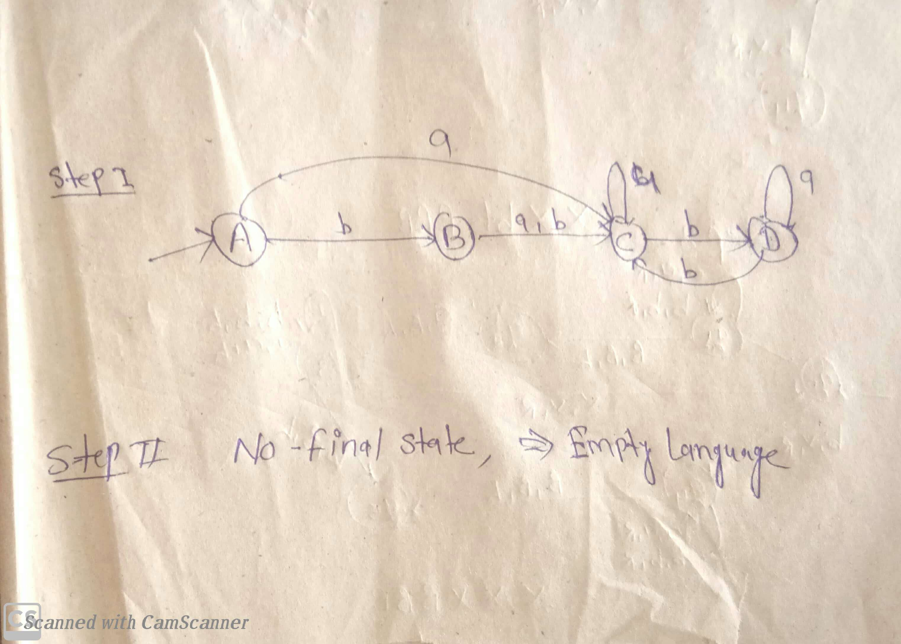

Slide 7
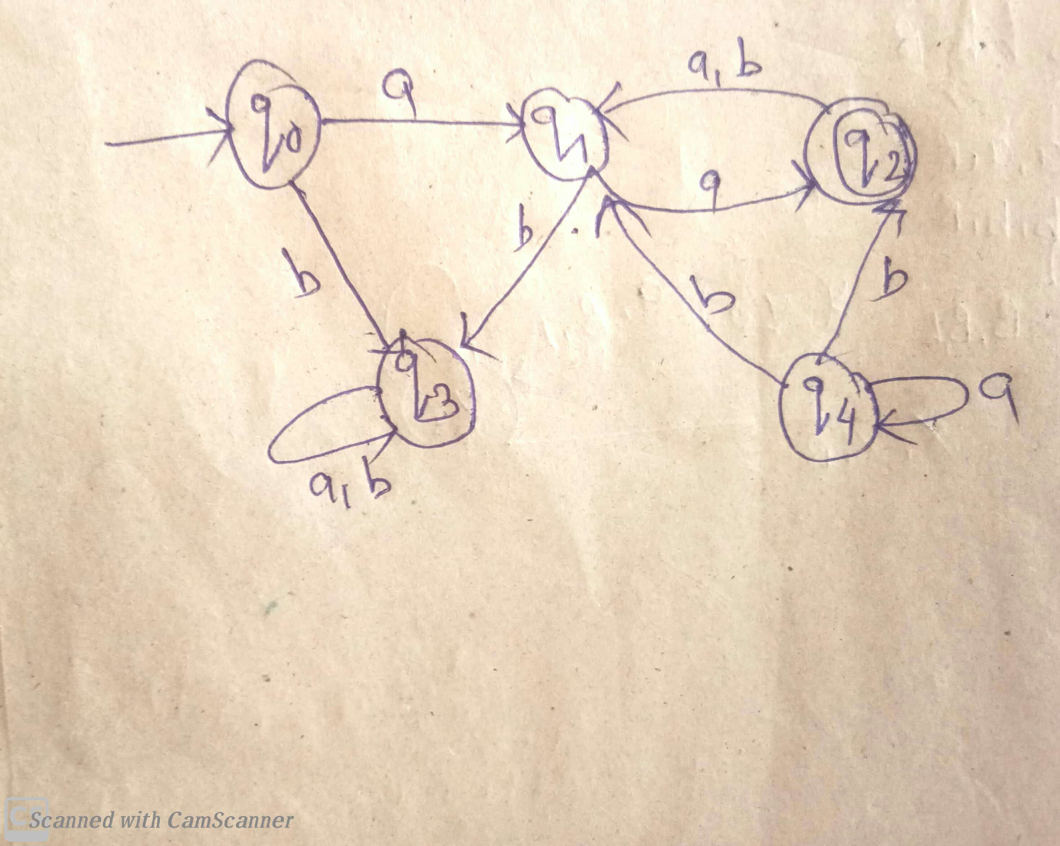

Slide 8
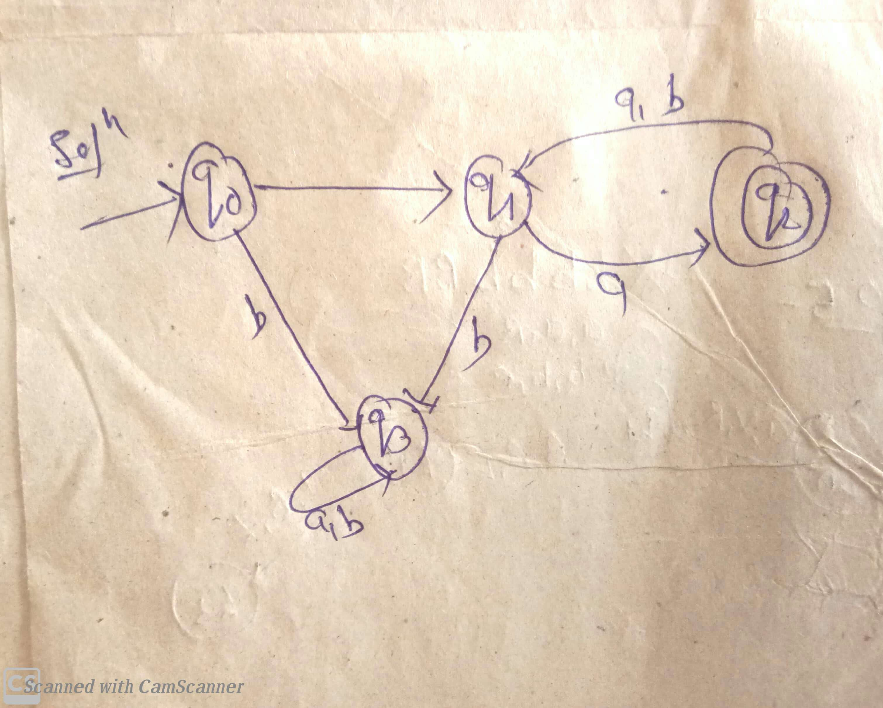

Slide 9
Finiteness Problem
Finiteness Problem: means checking whether
the language accepted by finite automata is
Finite or Infinite.
Step:1 Eliminating the Unreachable State from Initial State.
Step:2 Eliminating the those state ,from which we can not reach to Final State.
Step:3 In the resultant automata if there exist any loop or cycle or self loop then automata will accept Infinite Language, otherwise Finite Language accepted.

Slide 10
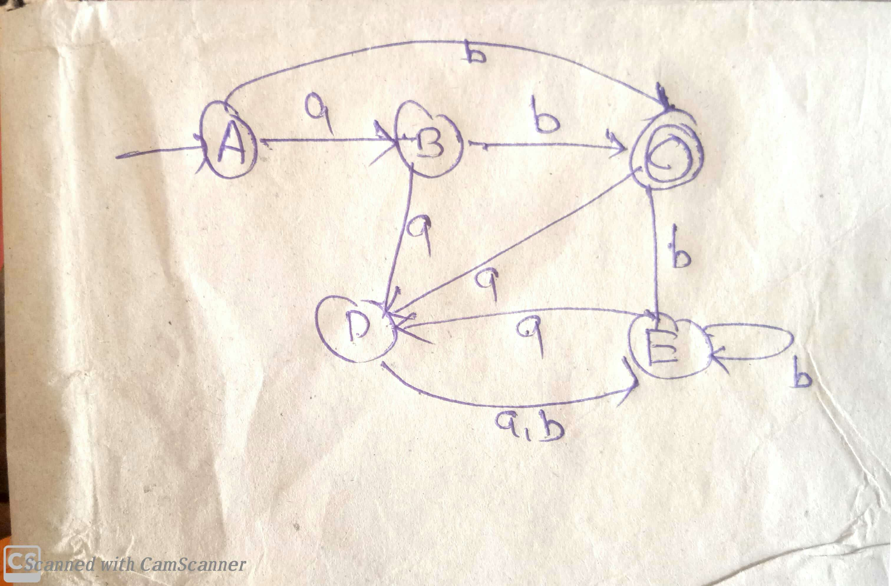

Slide 11
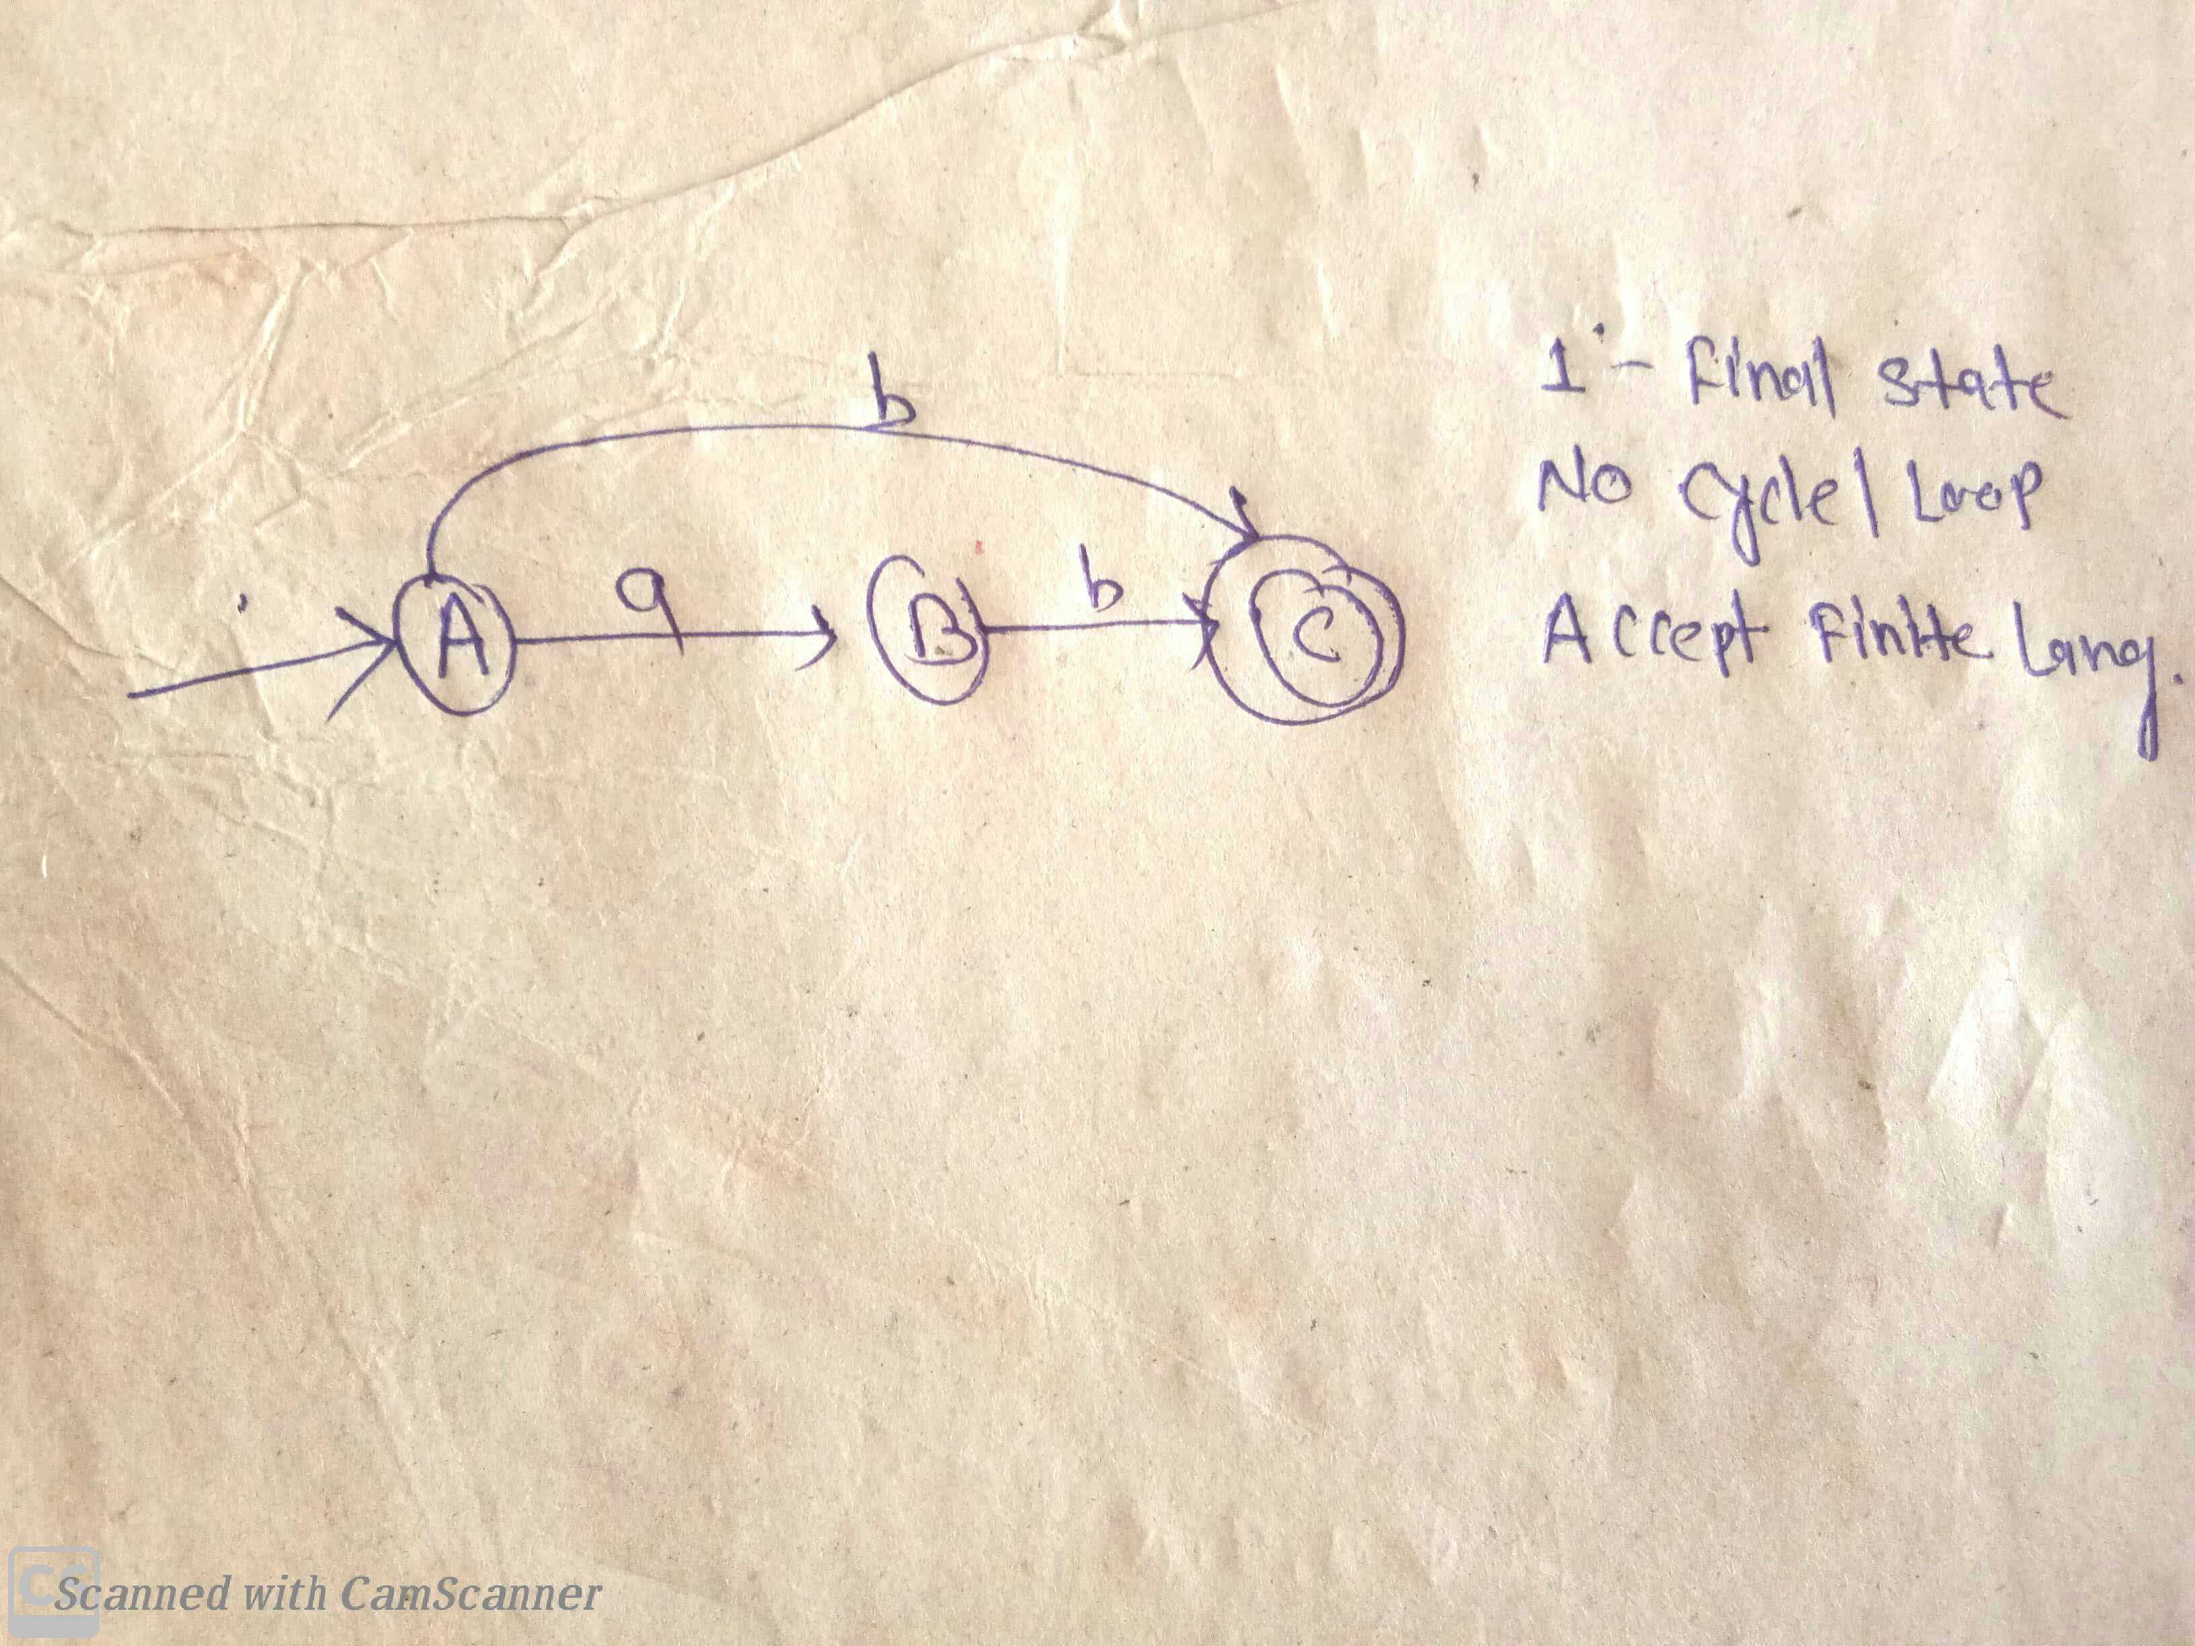

Slide 12
Equivalence Problem
Equivalence Problem: Checking whether
language accepted by two Automata is Equal or
not.
So with the help of Comparison Table we can equivalent two automata.

Slide 13
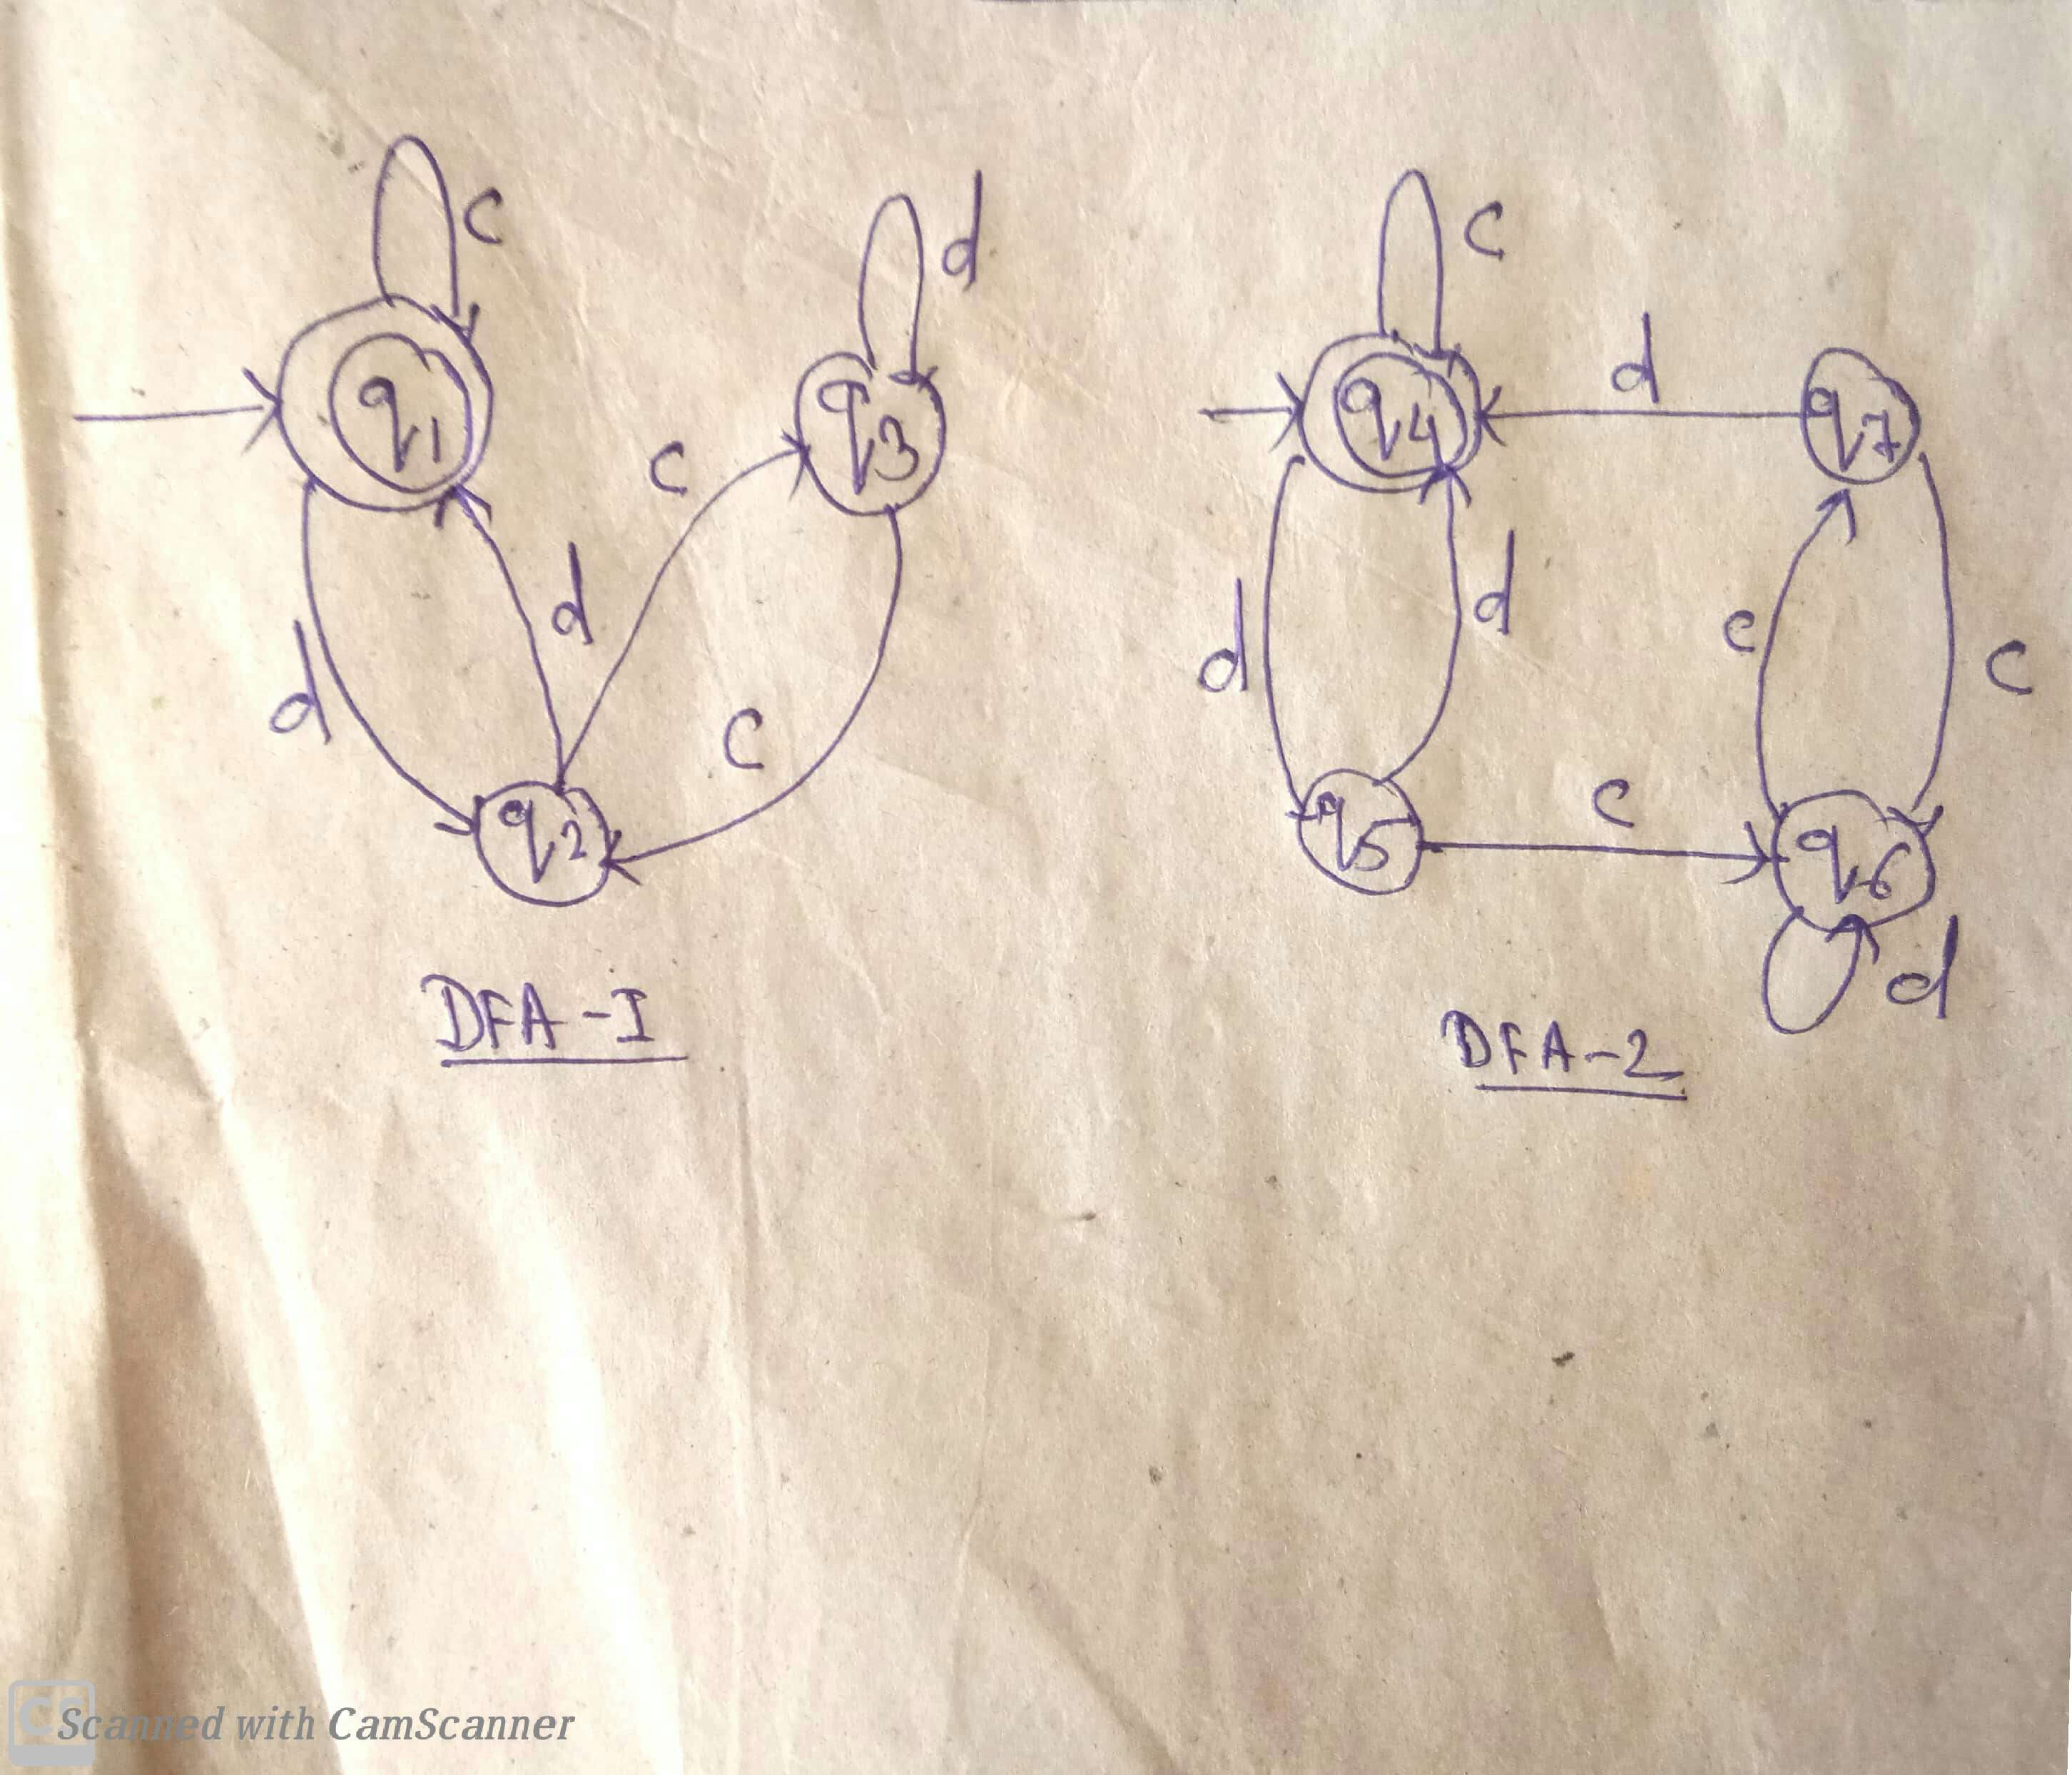

Slide 14
